Slide 1



COOLING AND VENTILATION (IC) OF THE THREE-PHASE INDUCTION MOTOR
EPE3020 - GROUP 8

Slide 2
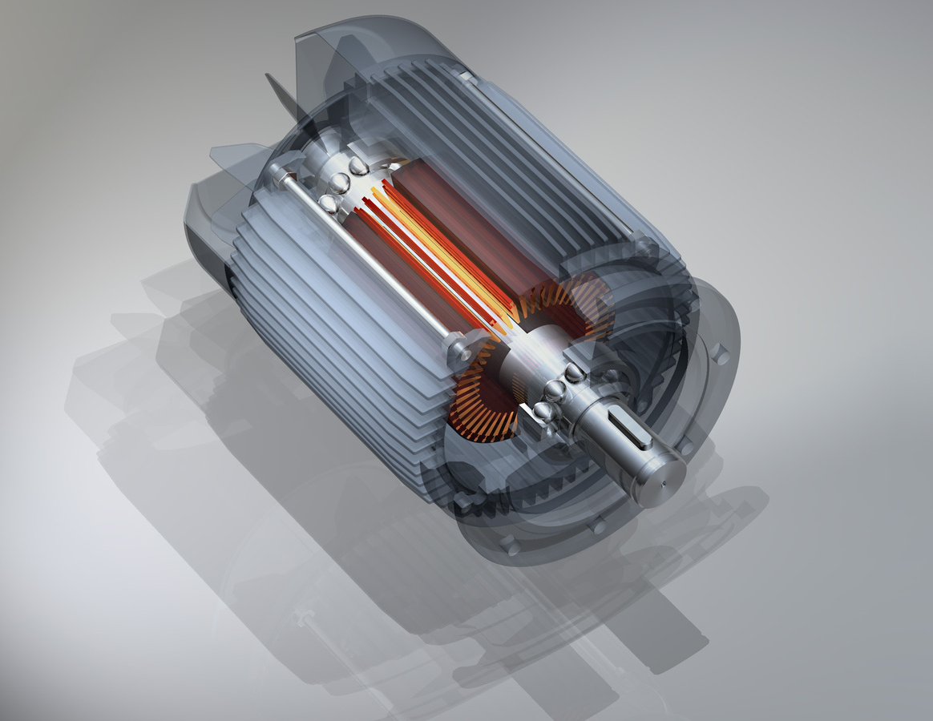
CONTENTS:
Introduction
Overview
Cooling means for induction motors
Induction motors using cryogenic cooling
Conclusion
References

Slide 3
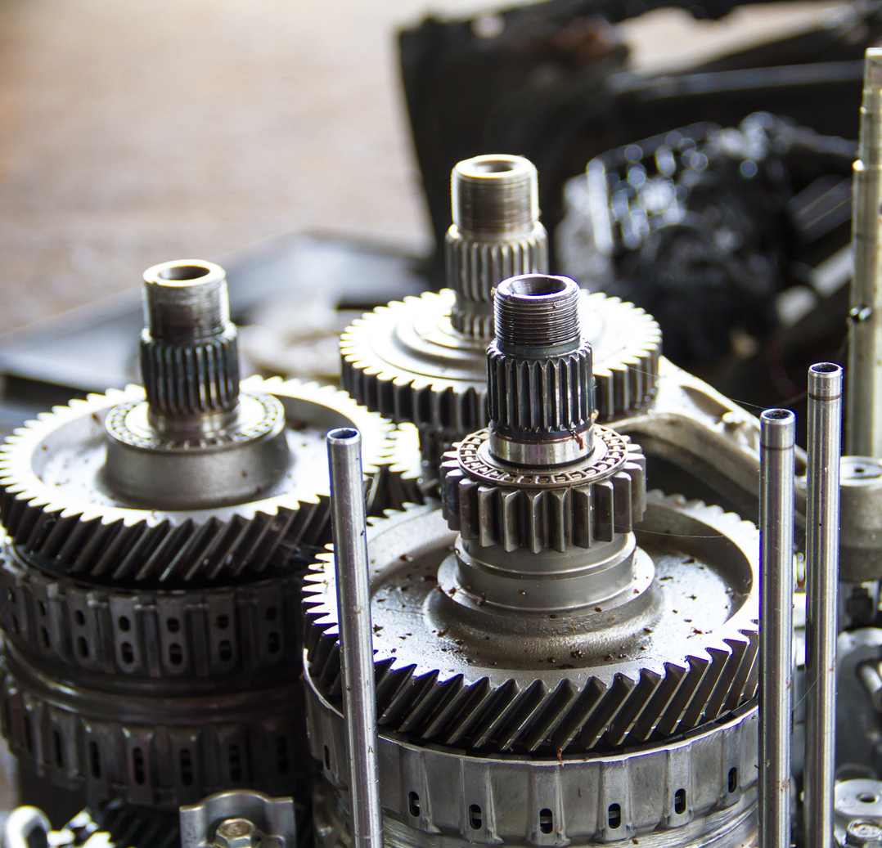
INTRODUCTION
It is known that the effect of electric resistance and magnetic losses (either hysteresis or eddy currents) or the friction losses from rotation takes the form of heat losses.
All these losses decrease the efficiency and lifespan of any electric machine. Thus, several efforts were made to dissipate these heat loss.
There are various methods to cool or ventitalate a machine from self cooling fans to more complex methods using special cooling medium.

Slide 4
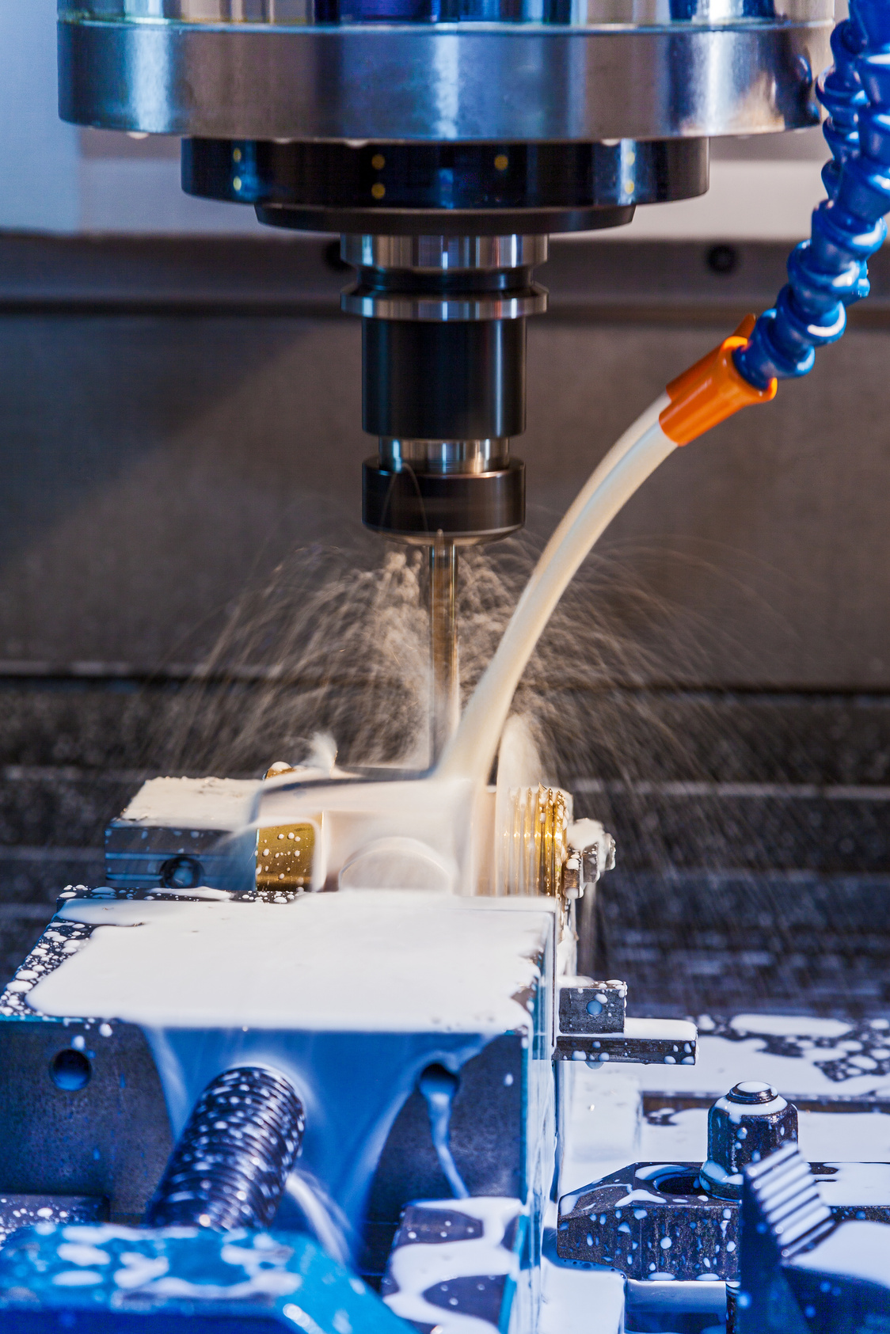
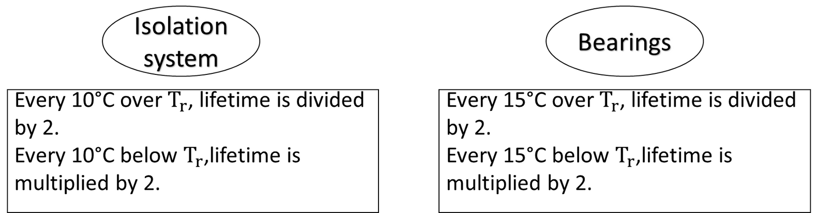
OVERVIEW
WHY IS COOLING NEEDED?
When an electric motor is in operation, the rotor and stator losses generate heat.
Efficient cooling has a significant impact on the lifetime of motor.
The most vulnerable components to overheating are the isolation system and the bearings.

Slide 5
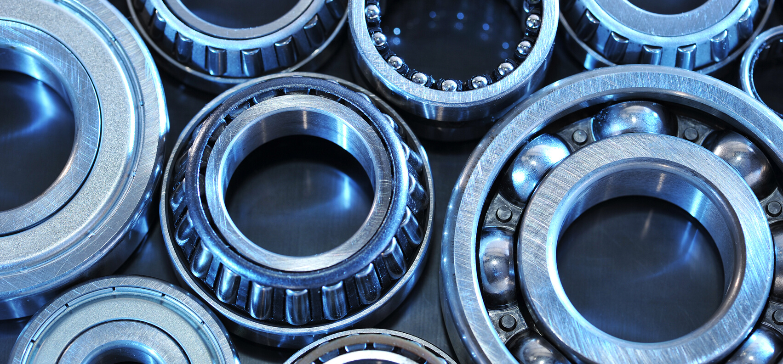
OVERVIEW
WHAT ARE THE BENEFITS OF APPROPRIATE COOLING?
Efficient cooling has a significant impact on the lifetime of motor.
The most vulnerable components to overheating are the isolation system and the bearings.

Slide 6
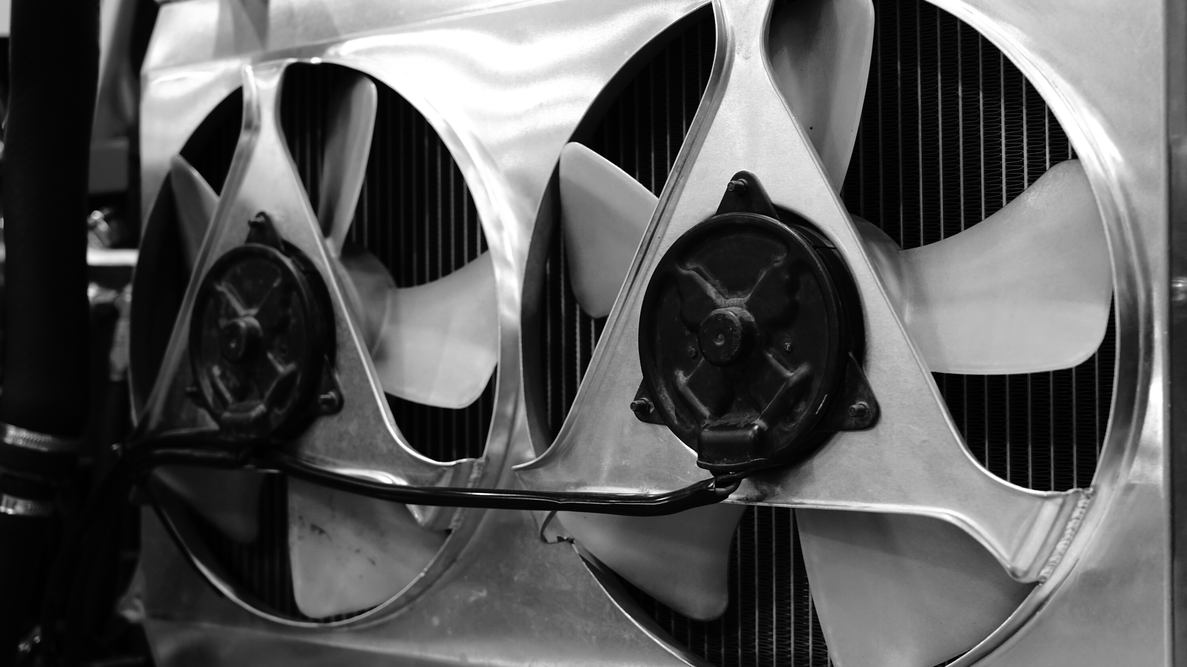
OVERVIEW
HOW TO CHOOSE THE BEST COOLING METHOD?
THE APPLICATION
The type of use with which the motor will be used critically defines the loading conditions as well as the rated values.

Slide 7
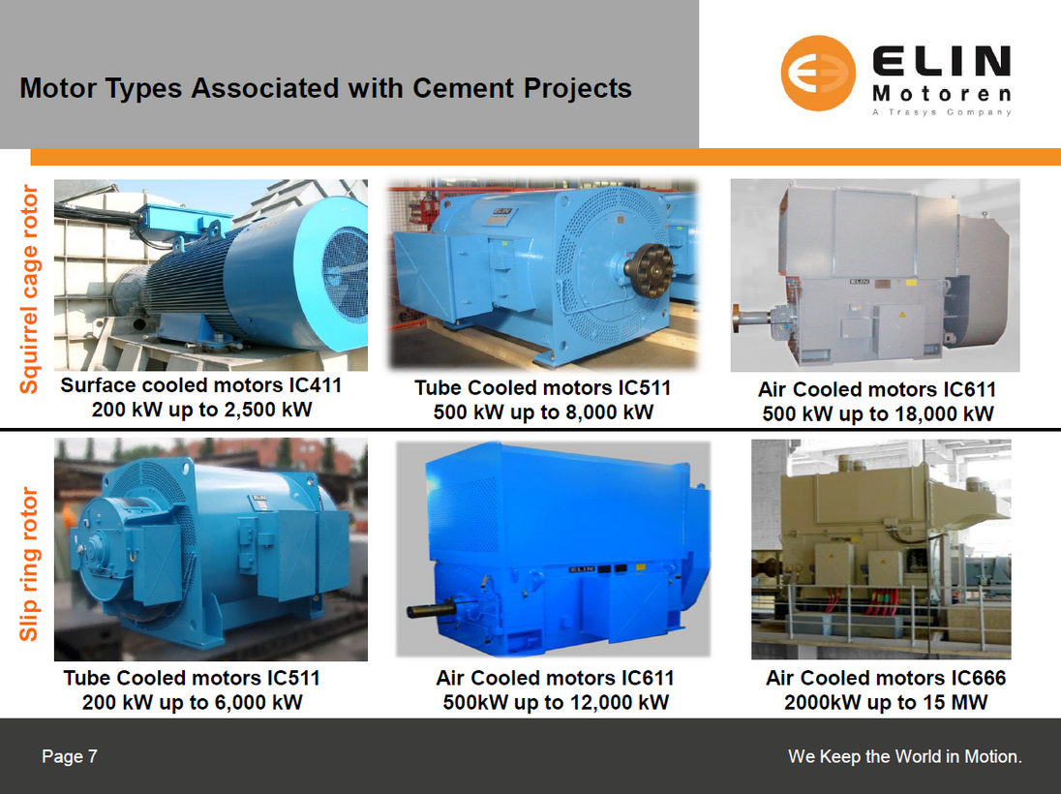
OVERVIEW
HOW TO CHOOSE THE BEST COOLING METHOD?
THE APPLICATION
Not only does the motor's cooling method depend on the voltage level and the protection type (IP number), but also, the application in which the machine will be used at.

Slide 8
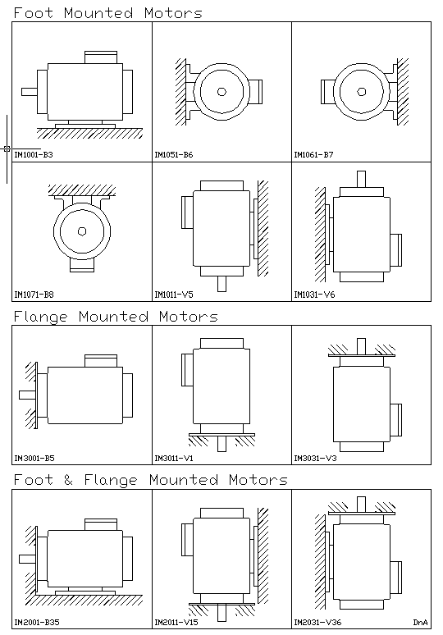
OVERVIEW
HOW TO CHOOSE THE BEST COOLING METHOD?
WHERE THE MOTOR IS MOUNTED?
The mounting code (IM code according to IEC standard 60034-7) takes into account:
The position of the motor shaft
The type of bearing shield
Fastening of the machine
Method of installation
Nature of the shaft end

Slide 9
OVERVIEW
HOW TO CHOOSE THE BEST COOLING METHOD?
OPERATING ENVIRONMENT
Most industrial motors are used in well ventilated areas to provide sufficient cooling. However, some may require a higher protection against the environment (higher IP) and thus a higher IC cooling code.

Slide 10
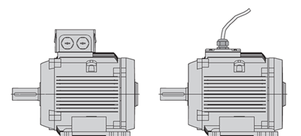
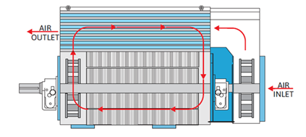
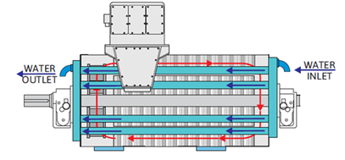
COOLING MEANS FOR INDUCTION MOTORS
Common cooling medium markings: "air" is A; "water" is W. In case, the cooling medium air mark A, it can be omitted.
Examples on cooling IC codes are:
IC410 - TENV - Totally Enclosed Naturally Ventilated (No fan)
IC611 - (formerly IC 0161) - CACA - Air-Air cooling with integral fan on motor's shaft inside stator and heat exchanger with open external circuit with fan on motor's shaft.
IC31W - Air-Water cooling with inlet and outlet pipe or duct for cooling water circulation.

Slide 11
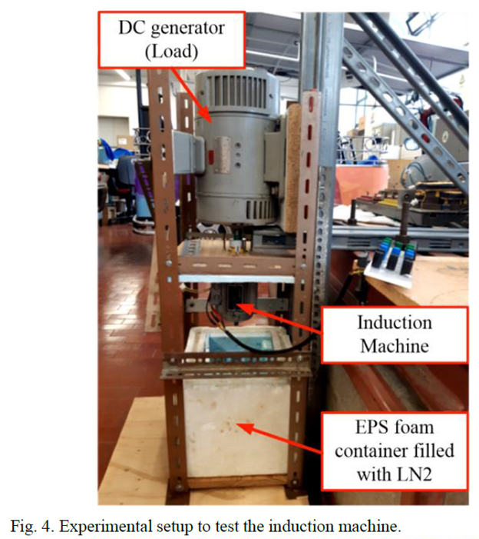
INDUCTION MOTORS USING CRYOGENIC COOLING
The apparatus setup of the experiment.

Slide 12
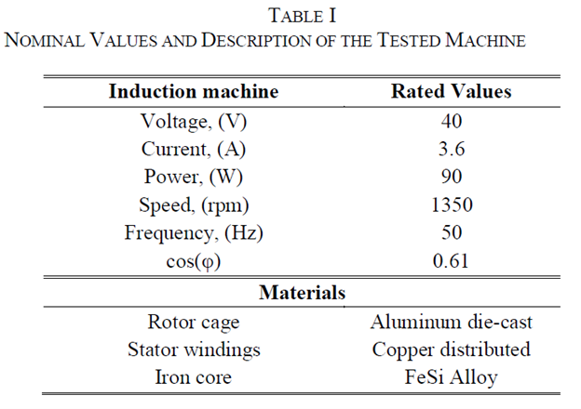
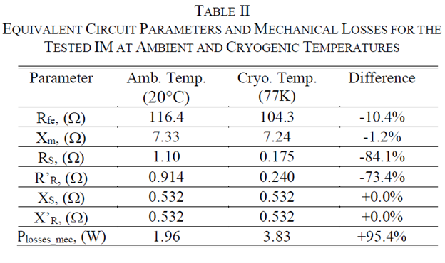
MACHINE CHARACTERISTICS

Slide 13
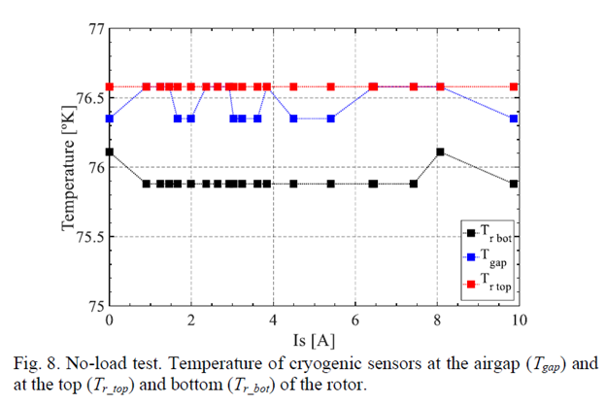
TEMPERATURE MEASUREMENT
In order to measure the temperature change according to the current level during the no load test, three separae temperature sensors were use, two of which are in cotact with the rotor (Tbot and Ttop) and the other was installed in the air gap (Tgap)
When measuring the temperature of different parts of the rotor being immersed in LN2, it was found that all the parts did not exceed the boiling point of LN2 (i.e. 77K) but there was quite a small gradient in temperature.

Slide 14
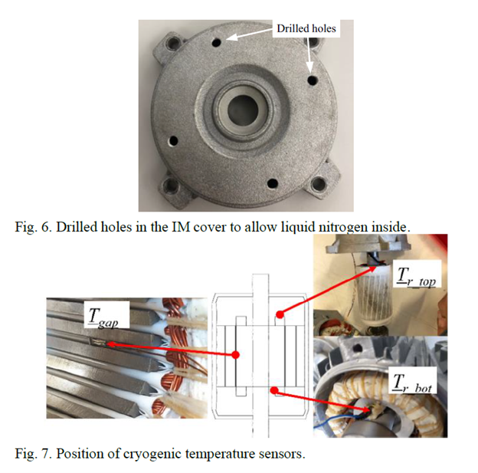
EXPERIMENTAL SETUP

Slide 15
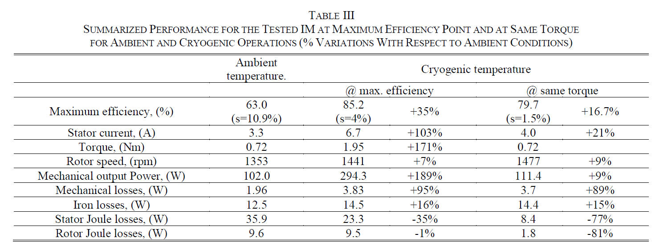
OUTPUT VALUES
Comparison between ambient temperature and cryogenic conditions (each at maximum efficiency)

Slide 16
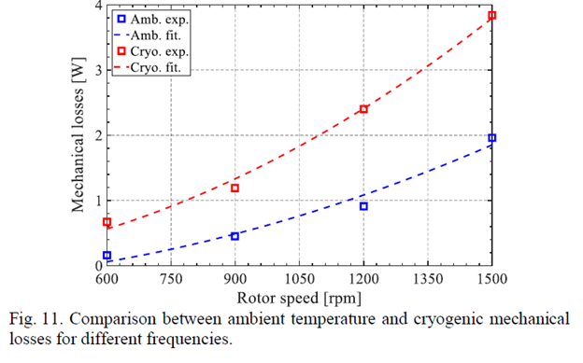
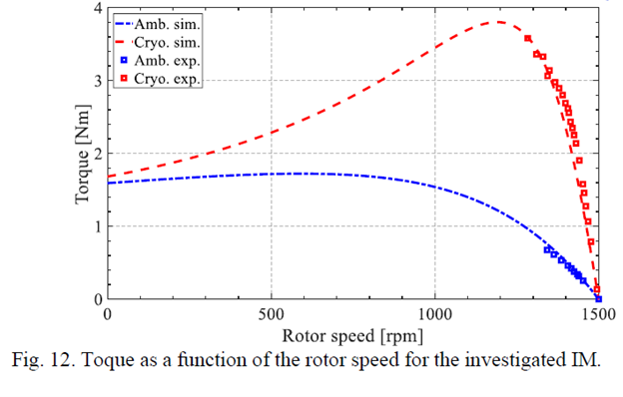
OUTPUT VALUES
Comparison between ambient temperature and cryogenic conditions

Slide 17

CONCLUSION
Several efforts have been made to deal with the heat losses during machine operation. The IEC standard specifies the cooling mode, that is, the medium to be used and the type of external cooling installations (e.g., external cooling fan, water pump, etc.).
There are other cooling methods such as cooling using liquid nitrogen LN2 to circulate inside the machine parts (i.e. rotor, stator and air gap) to ensure maximum possible efficiency.

Slide 18
REFERNCES
Bucho, L. F., Fernandes, J. F., Biasion, M., Vaschetto, S., & Cavagnino, A. (2022, June 17). Experimental Assessment of Cryogenic Cooling Impact on Induction Motors. IEEE Transactions on Energy Conversion, pp. 1-8. doi:10.1109/TEC.2022.3183939
Folie 1. (2017, January). Retrieved from ELIN Motoren GmbH Website: http://elinmotoren.ir/uploads/pages/files/1518958240YYRiUMz9EQV1a9nHOI968j4JCDUaGtAwopLvpXGq.pdf
What is an IM code, and what types of electrical machines are there? (2008, December 8). Retrieved from Siemens Corporation Website: https://support.industry.siemens.com/cs/document/30320280/what-is-an-im-code-and-what-types-of-electrical-machines-are-there-?dti=0&lc=en-BO

